Slide 1
EXTRINSIC SEMICONDUCTOR
In an extrinsic semiconducting material, the charge carriers originate from impurity atoms added to the original material is called impurity [or] extrinsic semiconductor.
This Semiconductor obtained by doping TRIVALENT and PENTAVALENT impurites in a TETRAVALENT semiconductor. The electrical conductivity of pure semiconductors may be changed even with the addition of few amount of impurities.
Dr. S. RANJITH / Physics, SRM IST

Slide 2
DOPING
The method of adding impurities to a pure semiconductor is known as DOPING, and the impurity added is called the dopping agent(Ex-Ar,Sb,P,Ge and Al).
The addition of impurity would increases the no. of free electrons and holes in a semiconductor and hence increases its conductivity.
SORTS OF SEMICONDUCTOR according to ADDITION OF IMPURITIES
n-type semiconductor
p-type semiconductor
Dr. S. RANJITH / Physics, SRM IST

Slide 3
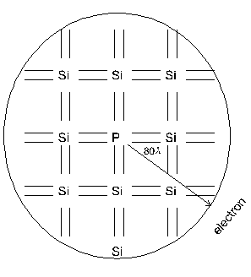
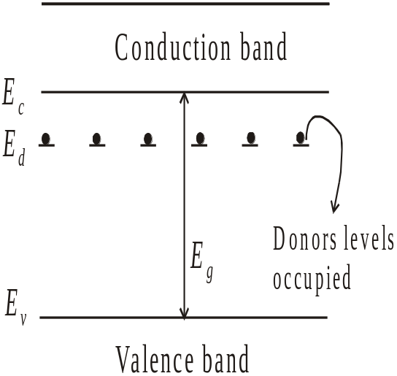
N – type semiconductor
When pentavalent impurity is added to the intrinsic semiconductors, n type semi conductors are formed.
n - type semiconductor
At T = 0K
Dr. S. RANJITH / Physics, SRM IST

Slide 4
When small amounts of pentavalent impurity such as phosphorous are added during crystal formation, the impurity atoms lock into the crystal lattice[ see above Fig).
Consider a silicon crystal which is doped with a fifth column element such as P, As or Sb.
Four of the five electrons in the outermost orbital of the phosphorus atom take part in the tetrahedral bonding with the four silicon neighbours.
The fifth electron cannot take part in the discrete covalent bonding. It is loosely bound to the parent atom.
Dr. S. RANJITH / Physics, SRM IST

Slide 5
It is possible to calculate an orbit for the fifth electron assuming that it revolves around the positively charged phosphorus ion, in the same way as for the “1s” electron around the hydrogen nucleus.
The electron of the phosphorus atom is moving in the electric field of the silicon crystal and not in free space, as is the case in the hydrogen atom.
This brings in the dielectric constant of the crystal into the orbital calculations, and the radius of the electron orbit here turns out to be very large, about 80 Å, as against 0.5 Å for the hydrogen orbit. Such a large orbit evidently means that the fifth electron is almost free and is at an energy level close to the conduction band.
Dr. S. RANJITH / Physics, SRM IST

Slide 6
At OK, the electronic system is in its lowest energy state, all the valence electron will be in the valence band and all the phosphorous atoms will be un-ionised.
The energy levels of the donor atoms are very close to the conduction band.
In the energy level diagram, the energy level of the fifth electron is called donor level. The donor level is so close to the bottom of the conduction band.
Most of the donor level electrons are excited into the conduction band at room temperature and become majority charge carriers.
Dr. S. RANJITH / Physics, SRM IST

Slide 7
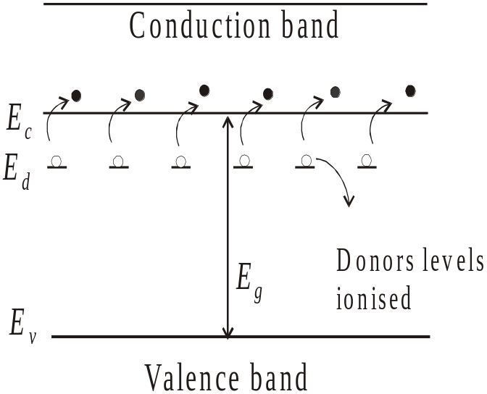
At T > 0K
At T = 300K
If the thermal energy is sufficiently high, in addition to the ionization of donor impurity atoms, breaking of covalent bonds may also occur thereby giving rise to generation of electron hole pair.
Dr. S. RANJITH / Physics, SRM IST

Slide 8
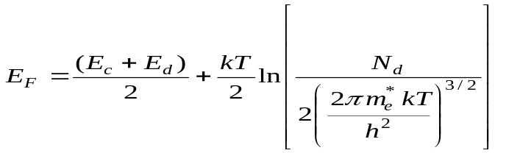
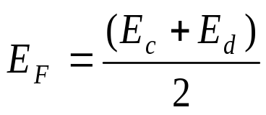
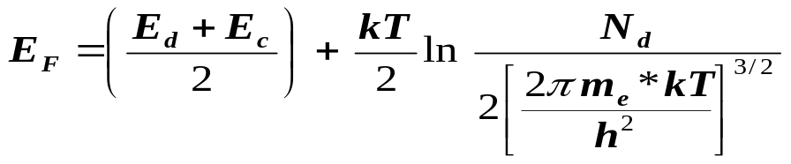
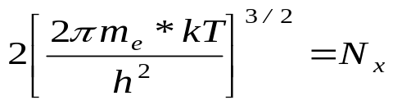
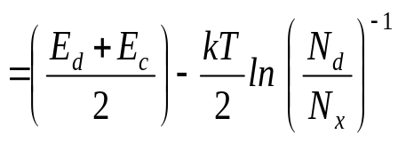
Fermi energy
The Fermi energy for n – type semiconductor is given by
At 0 K,
Variation of Fermi level with temperature
The Fermi energy is given by,
Let
Dr. S. RANJITH / Physics, SRM IST

Slide 9
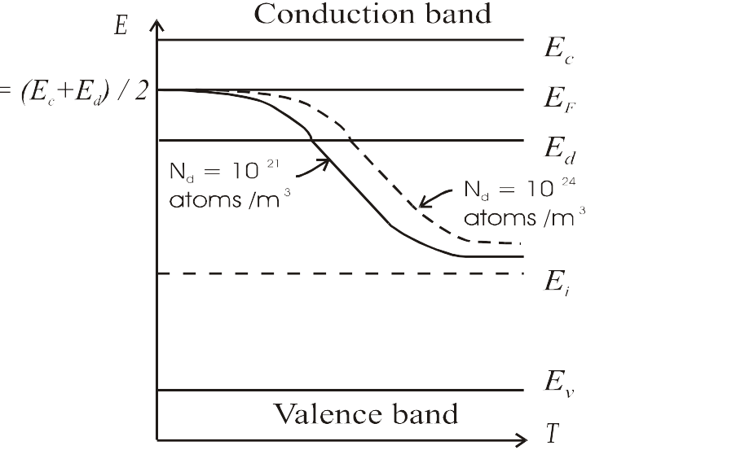
Variation of Fermi level with donor concentration with temperature
  As T increases, Fermi level drops. Also for a given temperature the Fermi level shift upward as the concentration increases.
  We can say that E_{F} decreases slightly with increase in temperature.
  As the temperature is increased, more and more donor atoms are ionized. For a particular temperature all the donor, atoms are ionized.
Dr. S. RANJITH / Physics, SRM IST

Slide 10
  Further increase in temperature results in generation of electron-hole pairs due to the breaking of covalence bonds and the material tends to behave in intrinsic manner. The Fermi level gradually moves towards the intrinsic Fermi level E_{i} .
P -Type Semiconductor
When trivalent impurity is added to intrinsic semiconductor, P type semi conductors are formed.
Al has three electrons in the outer orbital. While substituting for silicon in the crystal, it needs an extra- electron to complete the tetrahedral arrangement of bonds around it.
Dr. S. RANJITH / Physics, SRM IST

Slide 11
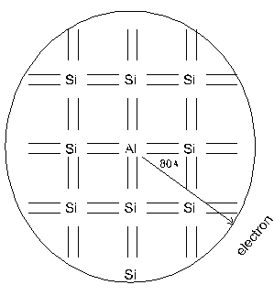
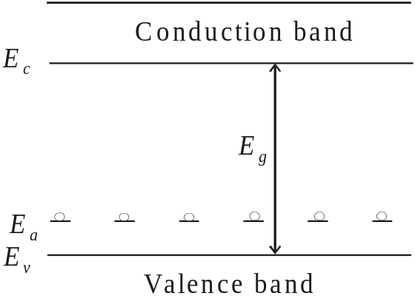
The extra electron can come only from one of
the neighbouring silicon atoms, thereby creating a vacant electron site (hole) on the silicon.
The aluminium atom with the extra electron becomes a negative charge and the hole with a positive charge can be considered to resolve around the aluminium atom, leading to the same orbital calculations as above T.
p - type semiconductor
At T = 0K
Dr. S. RANJITH / Physics, SRM IST

Slide 12
Since the trivalent impurity accepts an electron, the energy level of this impurity atom is called acceptor level. This acceptor level lies just above the valence bond.
Even at relatively low temperatures, these acceptor atoms get ionized taking electrons from valence bond and thus giving to holes in the valence bond for conduction.
Due to ionization of acceptor atoms, only holes and no electrons are created.
Dr. S. RANJITH / Physics, SRM IST

Slide 13
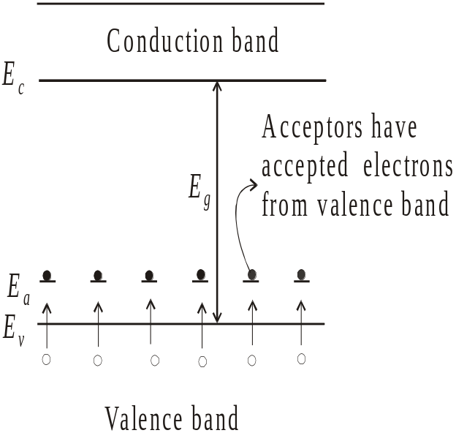
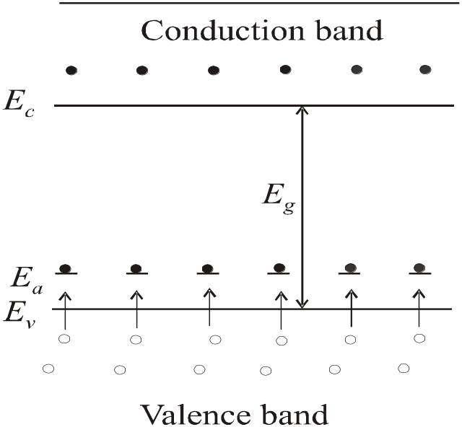
If the temperature is sufficiently high, in addition to the above process, electron-hole pairs are generated due to the breaking of covalent bonds.
Thus holes are more in number than electrons and hence holes are majority carriers and electrons are minority carriers
(a) At T > 0K (b) At T = 300K
Dr. S. RANJITH / Physics, SRM IST

Slide 14
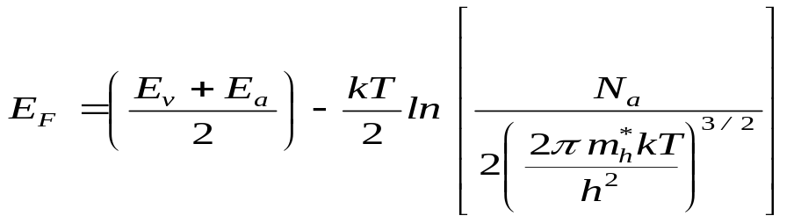
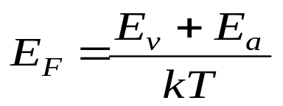
Fermi Energy
The Fermi energy for p – type semiconductor is given by
At 0 K,
At 0K, Fermi level is exactly at the middle of the acceptor level on the top of the valence band.
Dr. S. RANJITH / Physics, SRM IST

Slide 15
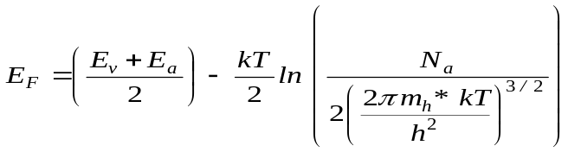
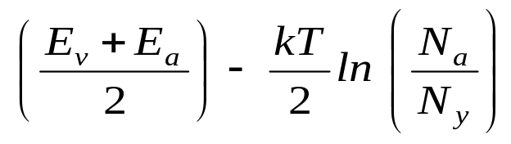
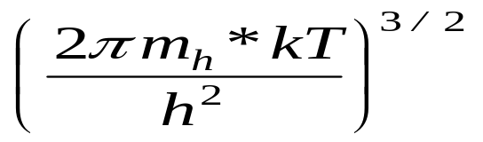
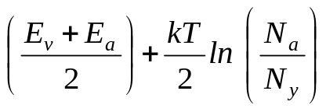
VARIATION OF FERMI LEVEL WITH
TEMPERATURE
=
where N_{y} = 2
and therefore E_{F} =
From the above eqn, it is seen that E_{F} increases slightly as the temperature increases.
As the temperature increases, more and more acceptor atoms are ionised.
Dr. S. RANJITH / Physics, SRM IST

Slide 16
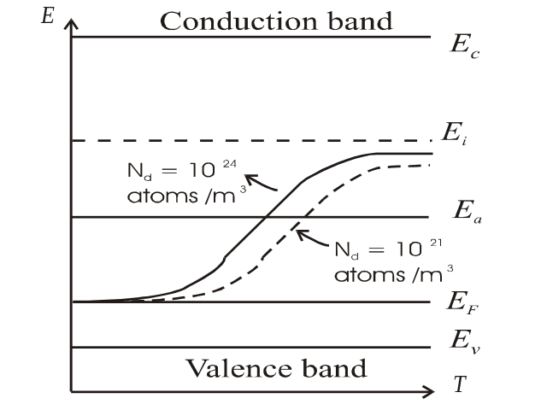
For a particular temperature all the acceptor atoms are ionized.
Further increase in temperature results in generation of electron-hole pair due to the breaking of covalent bonds and the material tend to behave in intrinsic manner.
The Fermi level gradually moves towards the intrinsic Fermi level.
N_{a}
N_{a}
Variation of Fermi level with acceptor concentration and temperature
Dr. S. RANJITH / Physics, SRM IST

